Slide 1
Intro to NoSQL
Databases

Slide 2
What is NoSQL?
NoSQL databases (aka "not only SQL") are non-tabular databases and store data differently than relational tables.
They emerged in the late 2000s as the cost of storage dramatically decreased.
In 1956 cost of MB in US Dollars was $9200 which decreased over time and came down to $0.00001953 in 2022(equivalent to $0.02/GB).
As storage costs rapidly decreased, the amount of data that applications needed to store and query increased.

Slide 3
What is NoSQL?
This data came in all shapes and sizes — structured, semi-structured, and polymorphic — and defining the schema in advance became nearly impossible.
NoSQL databases allow developers to store huge amounts of unstructured data, giving them a lot of flexibility.

Slide 4
Architecture with NoSQL
In order to understand how to properly architect applications with NoSQL databases you must understand the separation of concerns between data management and data storage.
The past era of SQL based databases attempted to satisfy both concerns with databases.
This is very difficult, and inevitably applications would take on part of the task of data management, providing certain validation tasks and adding modeling logic.

Slide 5
Architecture with NoSQL
One of the key concepts of the NoSQL movement is to have DBs focus on the task of high-performance scalable data storage &
Provide low-level access to a data management layer in a way that allows data management tasks to be conveniently written in the programming language of choice
This way we don’t have to have data management logic spread across Turing-complete application languages, SQL, and sometimes even DB-specific stored procedure languages.

Slide 6
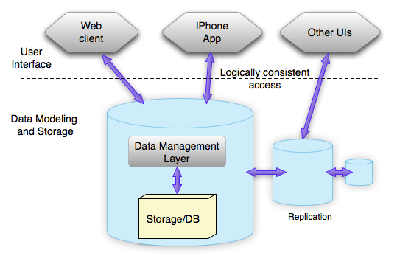
Architecture with NoSQL

Slide 7
Sharding
Sharding is a method for distributing a single dataset across multiple databases, which can then be stored on multiple machines.
This allows for larger datasets to be split into smaller chunks and stored in multiple data nodes, increasing the total storage capacity of the system.
By distributing the data across multiple machines, a sharded database can handle more requests than a single machine can.

Slide 8
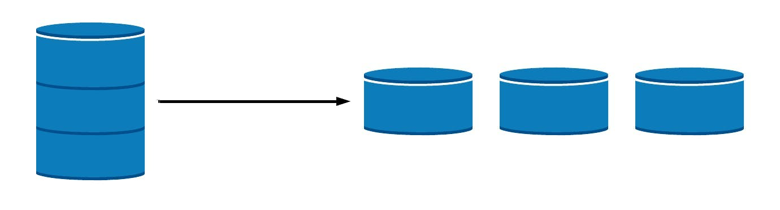
Sharding
Sharding is a form of scaling known as horizontal scaling or scale-out, as additional nodes are brought on to share the load.
Horizontal scaling allows for near-limitless scalability to handle big data and intense workloads.

Slide 9
Do you need database sharding?
Database sharding, as with any distributed architecture comes with an overhead and complexity in setting up shards, maintaining the data on each shard, and properly routing requests across those shards.
Before you begin sharding, consider if one of the following alternative solutions will work for you. By simply upgrading your machine, you can scale vertically without the complexity of sharding.
Adding RAM, upgrading your computer (CPU), or increasing the storage available to your database are simple solutions that do not require you to change the design of either your database architecture or your application.

Slide 10

Do you need database sharding?
By simply upgrading your machine, you can scale vertically without the complexity of sharding.
Adding RAM, upgrading your computer (CPU), or increasing the storage available to your database are simple solutions that do not require you to change the design of either your database architecture or your application.

Slide 11
Do you need database sharding?
Depending on your use case, it may make more sense to simply shift a subset of the burden onto other providers or even a separate database.
For example,
Blob or file storage can be moved directly to a cloud provider such as Amazon S3.
Analytics or full-text search can be handled by specialized services or a data warehouse.
Offloading this particular functionality can make more sense than trying to shard your entire database.

Slide 12
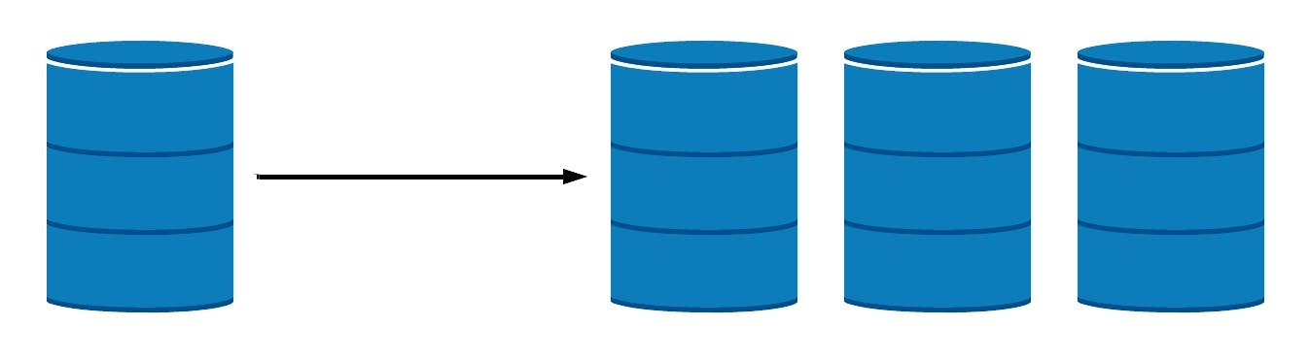
Replication
If your data workload is primarily read-focused, replication increases availability and read performance while avoiding some of the complexity of database sharding.
By simply spinning up additional copies of the database, read performance can be increased either through load balancing or through geo-located query routing.
However, replication introduces complexity on write-focused workloads, as each write must be copied to every replicated node.
Note: If your core application database contains large amounts of data, requires high read and high write volume, and/or you have specific availability requirements, a sharded database may be the way forward.

Slide 13
Advantages & Disadvantages of sharding
Advantages
Increased read/write throughput
Increased storage capacity
High availability
Disadvantages
Query overhead
Complexity of administration
Increased infrastructure costs

Slide 14
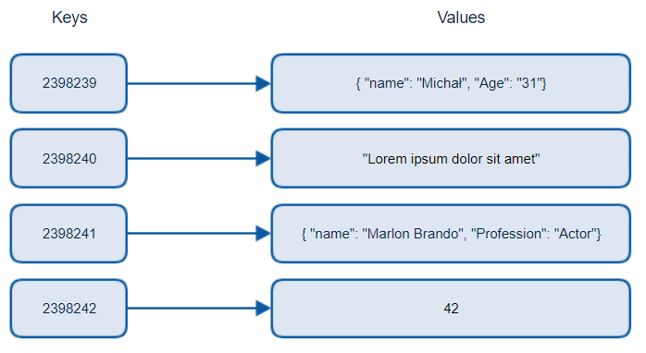
Taxonomy of NoSQL
Key-value stores
The data is stored in form of Key-Value Pairs.
The key is usually a sequence of strings, integers or characters but can also be a more advanced data type.
The value linked/co-related to the key can be of any type (JSON, BLOB(Binary Large Object), strings, etc)
The key-value pair storage databases generally store data as a hash table where each key is unique.
This type of pattern is usually used in shopping websites or e-commerce applications.

Slide 15
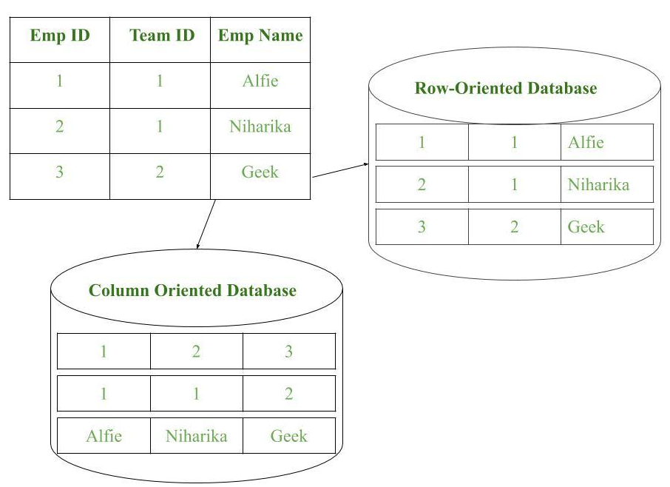
Taxonomy of NoSQL
Column-oriented databases
Data is stored in individual cells which are further grouped into columns.
Column-oriented databases work only on columns.
They store large amounts of data into columns together.
Every column is treated separately. But still, each individual column may contain multiple other columns like traditional databases.

Slide 16
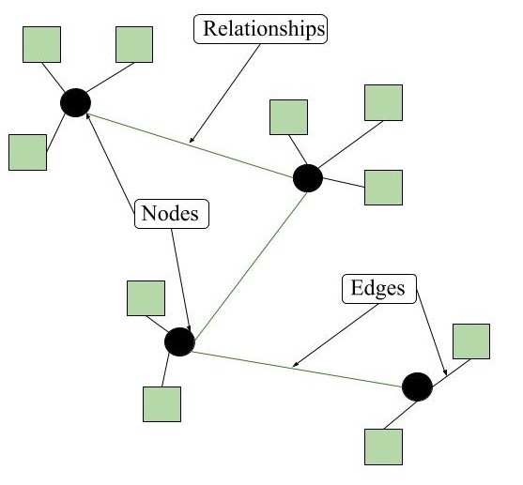
Taxonomy of NoSQL
Graph-based databases
Data is stored and managed in graphs
Graphs are basically structures that depict connections between two or more objects in some data.
The objects or entities are called as nodes and are joined together by relationships called Edges.
Each edge has a unique identifier. Each node serves as a point of contact for the graph.
This pattern is very commonly used in social networks where there are a large number of entities and each entity has one or many characteristics which are connected by edges.

Slide 17
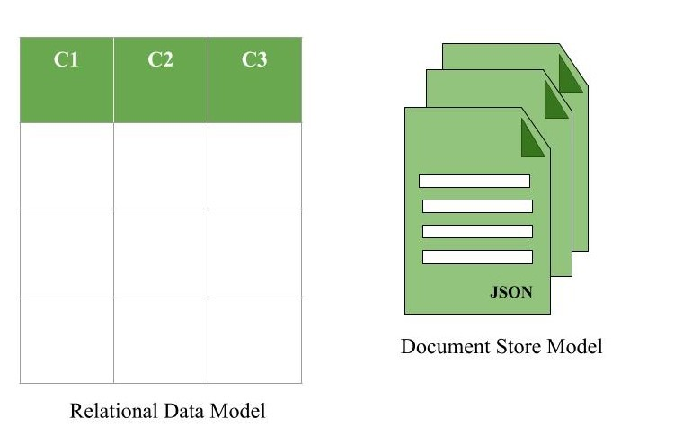
Taxonomy of NoSQL
Document-based databases
The document database fetches and accumulates data in form of key-value pairs but here, the values are called as Documents.
Store data in documents similar to JSON (JavaScript Object Notation) objects, BSON, or XML documents.
Each document contains pairs of fields and values. The values can typically be a variety of types including things like strings, numbers, booleans, arrays, or objects.
It is very effective as most of the data created is usually in form of JSONs and is unstructured.

Slide 18
CAP Theorem
CAP theorem or Eric Brewers theorem states that a distributed system can only provide two out of three guarantees simultaneously: Consistency, Availability and Partition Tolerance.
It is very important to understand the limitations of NoSQL database. NoSQL can not provide consistency and high availability together.
Consistency means that all nodes in the network see the same data at the same time.
Availability is a guarantee that every request receives a response about whether it was successful or failed.
Partition Tolerance is a guarantee that the system continues to operate despite arbitrary message loss or failure of part of the system.

Slide 19
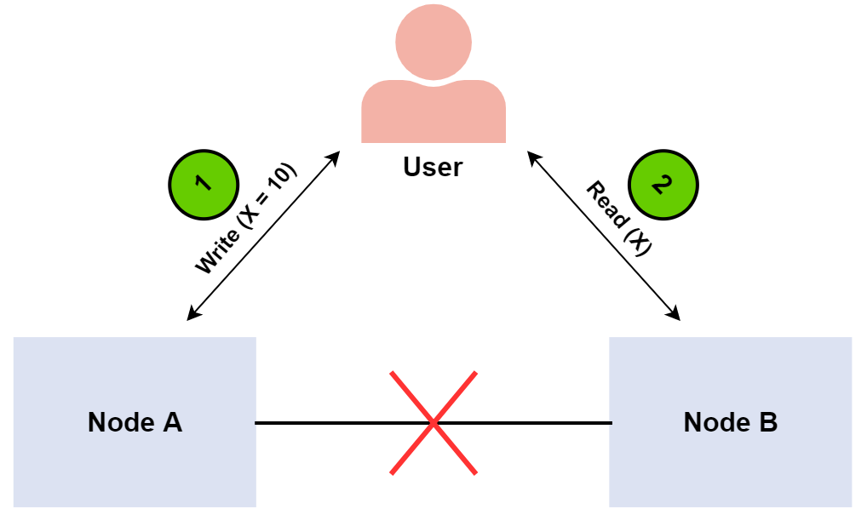
CAP Theorem Proof

Slide 20
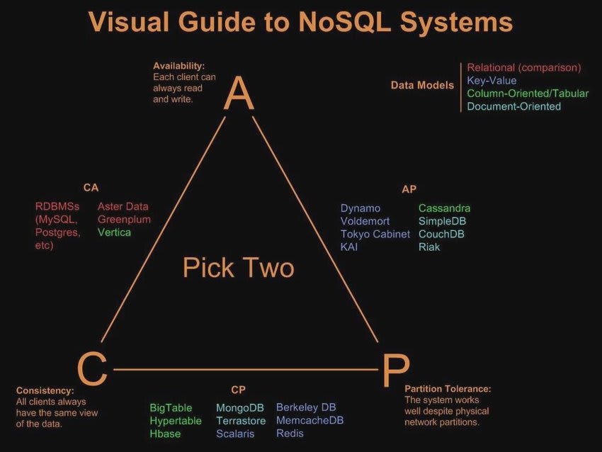
CAP Theorem

Slide 21
NoSQL vs RDBMS
SQL | NoSQL
RELATIONAL DATABASE MANAGEMENT SYSTEM (RDBMS) | Non-relational or distributed database system.
These databases have fixed or static or predefined schema | They have dynamic schema
These databases are not suited for hierarchical data storage. | These databases are best suited for hierarchical data storage.
These databases are best suited for complex queries | These databases are not so good for complex queries
Vertically Scalable | Horizontally scalable
Follows ACID property | Follows CAP(consistency, availability, partition tolerance)
Examples: MySQL, PostgreSQL, Oracle, MS-SQL Server etc | Examples: MongoDB, GraphQL, HBase, Neo4j, Cassandra etc

Slide 22
Benefits & Drawbacks of NoSQL
Benefits
Flexible Data Model
Evolving Data Model
Elastic Scalability
High Performance
Open-source
Drawbacks
Lack of Standardization
Backup of Database
Consistency

Slide 23
NoSQL BASE
In RDBMS ACID stands for Atomicity, Consistency, Isolated, Durable.
Whereas in NOSQL BASE stands for Basically Available, Soft state, Eventually consistent.
While the ACID model is focused on data consistency, the BASE model is focused on data availability.
Businesses use BASE Database Types to:
Use the object-oriented architecture native to the cloud
Process large amounts of unstructured data very quickly
Support data research
Find patterns, such as fraud
Gain business insights
Manage data from the Internet of Things (IoT)

Slide 24
Thank you!
Any Questions?

